Slide 1

Experiential Learning
Project Assessment-I on
“Personal Expense Tracker” under the course
Python Programming Language (N-PCCCM304P)
Presented By
Sinchan Abhishek Tambe
CM25054
Section A
Under the Guidance
of
Mrs. Mayuri Getme
Session:2026-27 (ODD )
Department of CSE(AI&ML)
S. B. JAIN INSTITUTE OF TECHNOLOGY MANAGEMENT AND RESEARCH,NAGPUR
An Autonomous Institute, Affiliated to RTMNU, Nagpur

Slide 2
Problem statement:
Personal Expense Tracker:
Develop a Python-based Personal Expense Tracker that helps users record, organize, and monitor their daily income and expenses. The application should allow users to add, view, update, and delete financial transactions, categorize expenses, calculate total income, total expenses, and current balance, and generate monthly or category-wise expense reports. The system should securely store financial records using file handling or a database and provide a simple, menu-driven interface for efficient personal finance management.
Objectives:
To design a menu-driven Python application for recording daily income and expenses.
To let users add, view, update, and delete financial transactions easily.
To categorize transactions (e.g. Food, Rent, Salary, Travel) for better organization.
To automatically calculate total income, total expenses, and current balance.
To generate monthly and category-wise reports for spending insights.
To ensure secure, persistent storage of records using file handling (CSV

Slide 3
Algorithm
Start the program
If it doesn't, create it and add column headings: Date, Type, Category, Amount.
Show the main menu on the screen with all the options: Add Transaction, View, Update, Delete, Reports, and Exit.
Ask the user to enter their choice.
If the user chooses Add Transaction:
Ask for the date, type (income or expense), category, and amount.
Check that everything was entered correctly — the date is in the right format, the amount is a positive number, and the type is either "Income" or "Expense."
If something is wrong, tell the user what's wrong and ask them to enter it again.
Once everything checks out, save this new entry into the file and show a "Transaction added successfully" message.
If the user picks View, Update, Delete, or Reports, show a message saying that feature is coming in the next stage of the project.
If the user chooses Exit, save everything and close the program.
If the user enters something that isn't a valid option, show an error and bring the menu back up.
Keep repeating steps 3 to 8 until the user exits.
End
Check whether the expense file (expenses.csv) already exists.

Slide 4
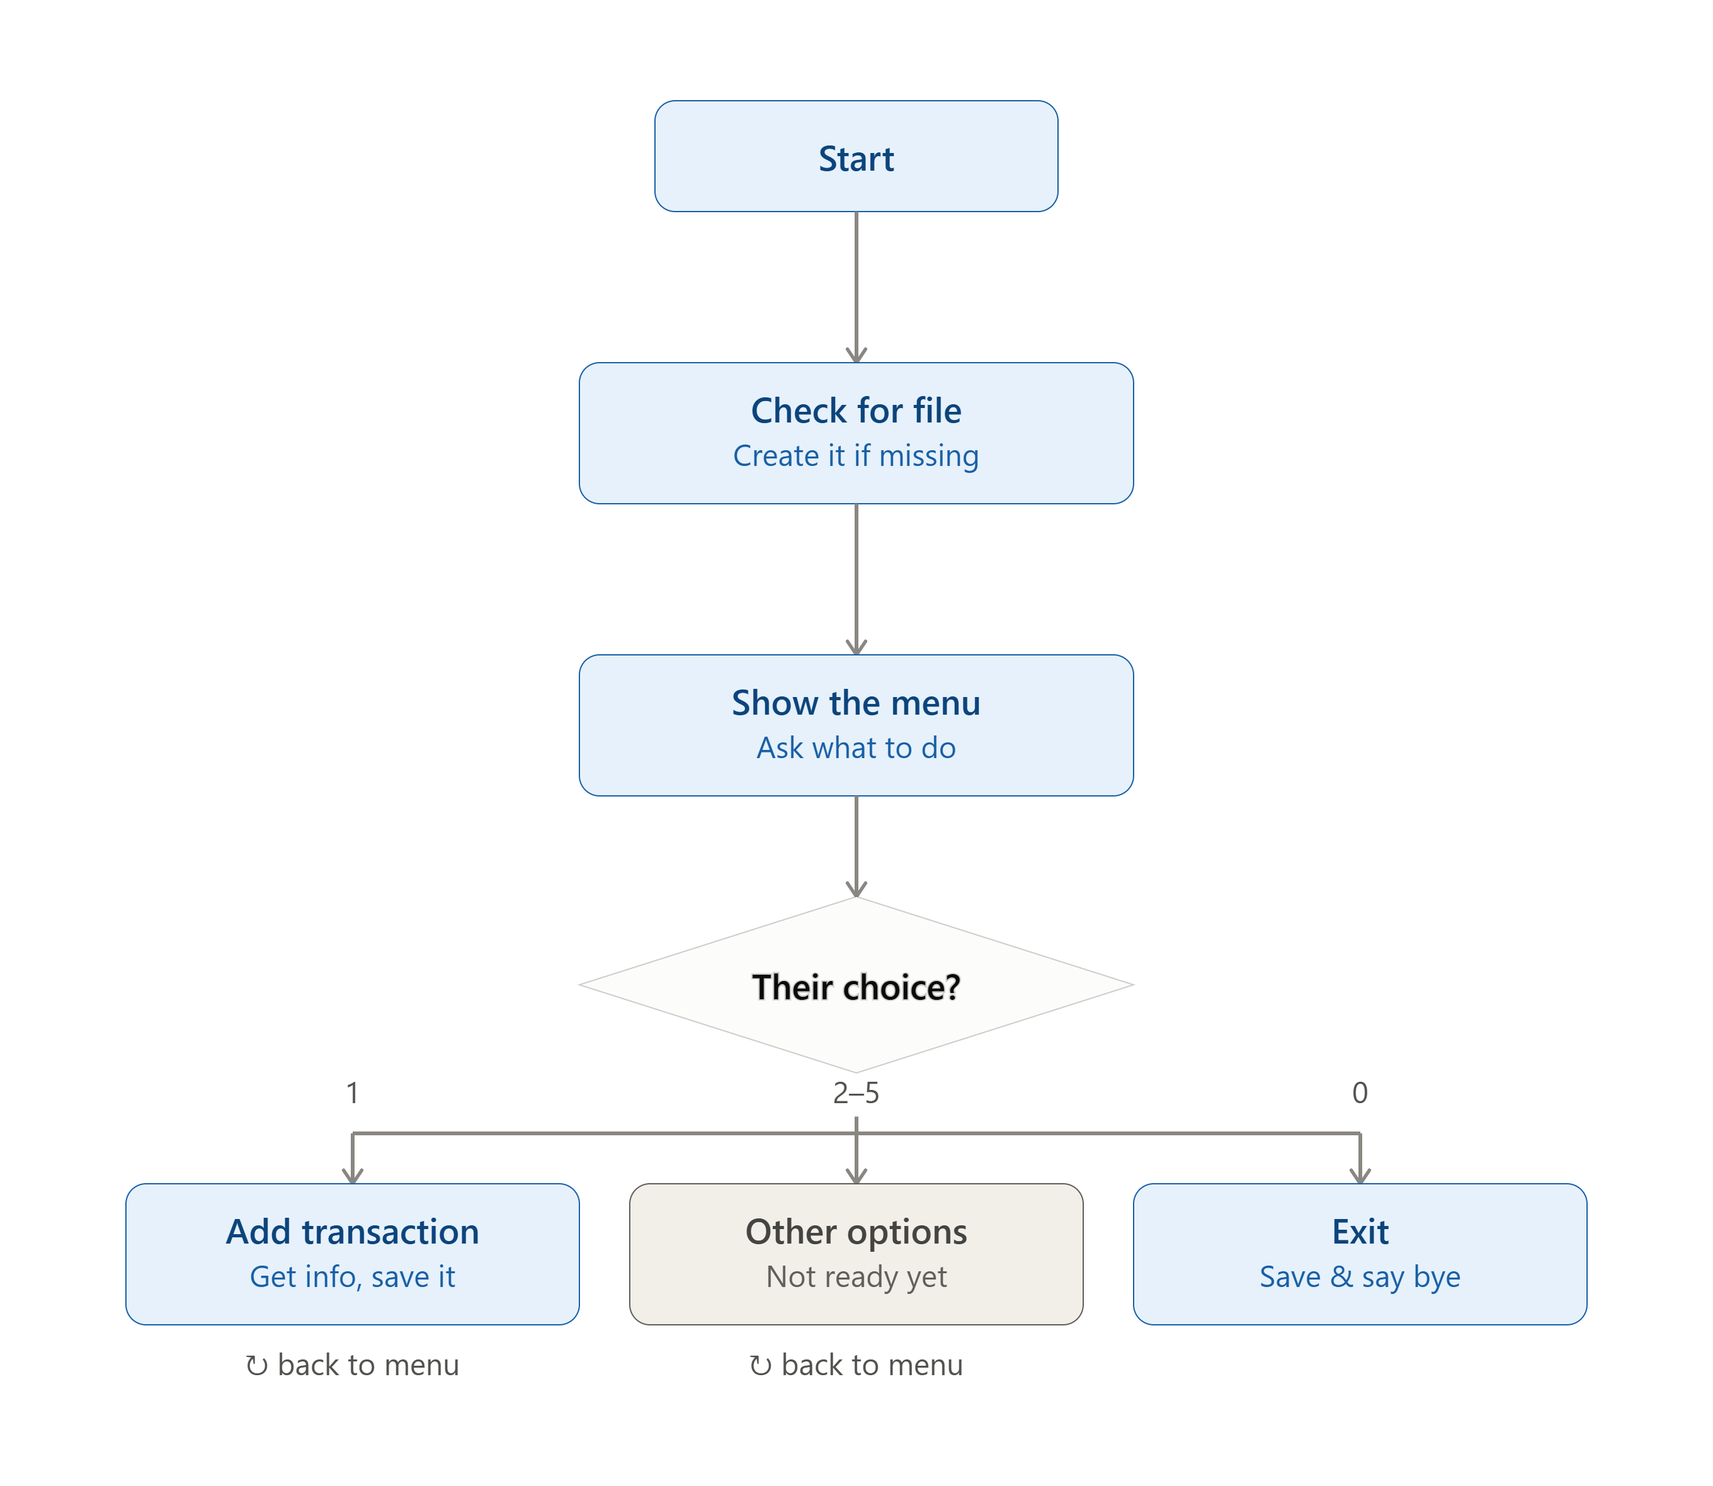
Flowchart/pseudocode

Slide 5
Understanding of Python logic
csv library — writes each transaction as a clean, structured row so the data can be read by Excel or Python itself.
os library — checks if expenses.csv already exists, so old data is never overwritten on restart.
Functions — the program is split into small tasks (add_transaction(), display_menu(), etc.), each doing one job.
Functions — the program is split into small tasks (add_transaction(), display_menu(), etc.), each doing one job.
If-elif-else — decides what to do based on the user's menu choice and checks the entry type is valid.
Try-except — catches invalid input (like typing text instead of a number) so the program doesn't crash.
File handling (append mode) — adds new transactions to the end of the file without deleting existing ones.

Slide 6
GitHub — Repository, Commits & Contribution
Account & repository — created a personal GitHub account and a repository, personal-expense-tracker, “Python lab”.
Initial setup — added README.md (problem statement + objectives) and a .gitignore for Python.
Uploading code — pushed the Module 1 code (menu skeleton + working Add Transaction) as the first commit.
Meaningful commits — descriptive messages tracking real progress, e.g.:
"Add file initialization and menu skeleton"
"Implement Add Transaction with input validation"
Collaboration — added mentor/instructor as a repository collaborator for review and feedback.
Individual contribution — solo project: 100% of design, coding, testing, and documentation done independently.

Slide 7



Phase 2 – Implementation
Started the practical implementation of the Python Personal Expense Tracker.
Developed a menu-driven Python program.
Implemented CSV file handling for storing transactions.
Added fields for Date, Type, Category, Amount and Description.
Python modules used:
csv
for storing and reading records
os
for checking the CSV file
datetime
for date validation
Data flow:
Python Program
Menu-driven application
CSV File
expenses.csv
Expense Records
Date, Type, Category, Amount, Description

Slide 8






Features Implemented
Add Transaction
Records income or expense with date, category, amount and description.
View Transactions
Displays all saved transactions.
Update Transaction
Allows existing transaction details to be modified.
Delete Transaction
Removes unwanted transactions.
View Summary
Calculates total income, total expenses, balance and category-wise totals.
Generate Reports
Generates monthly and category-wise reports and saves them in report.txt.

Slide 9
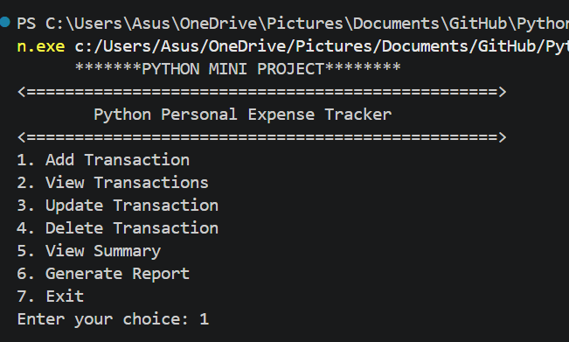
Output Screenshot:

Slide 10
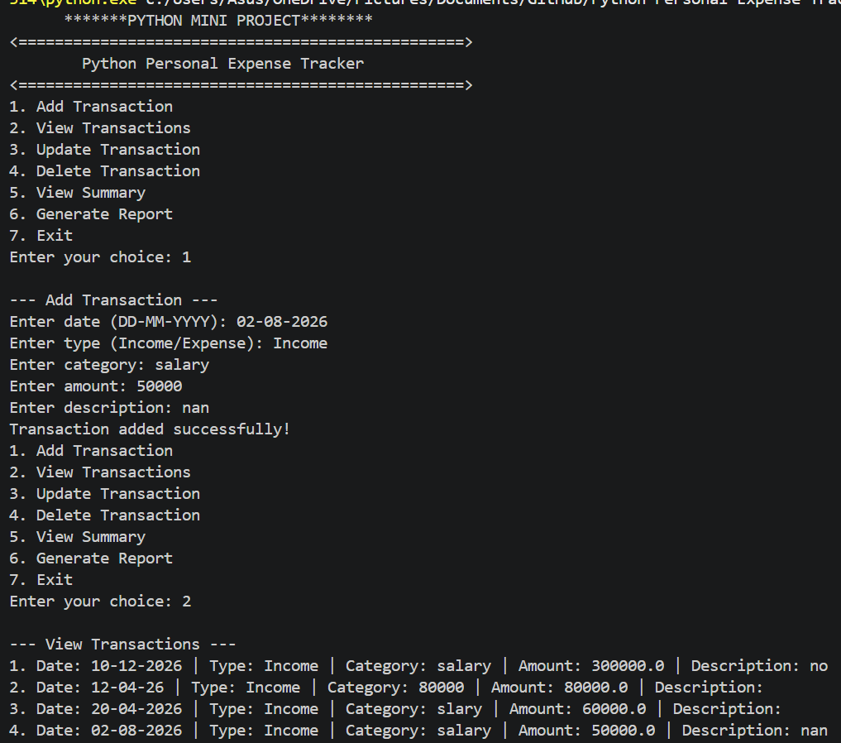
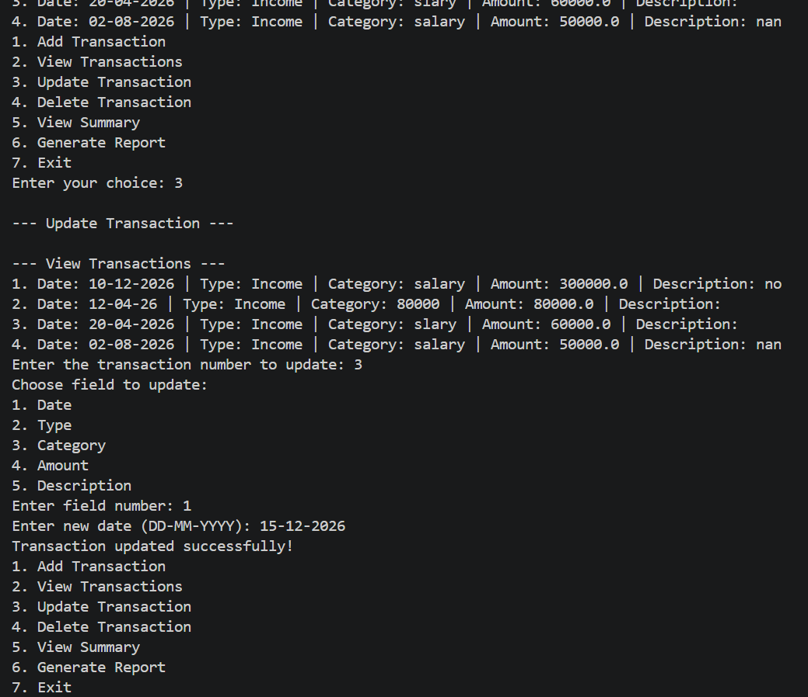

Slide 11
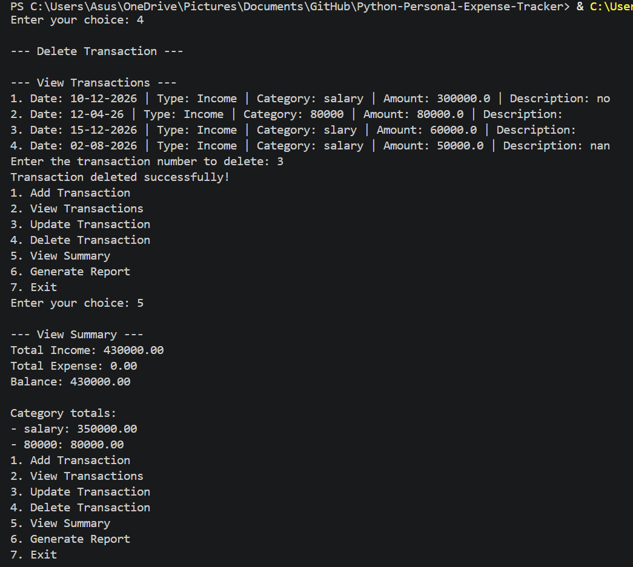
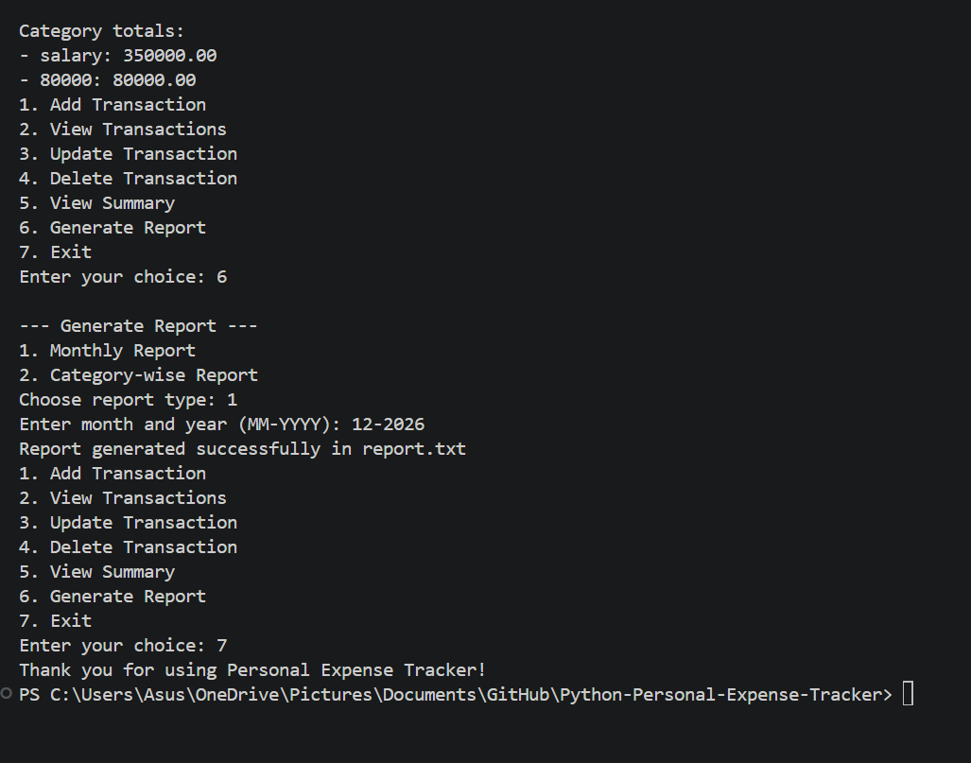

Slide 12


Project Progress – Phase 2
70% COMPLETED
30% REMAINING
Completed
Remaining 30%
CSV file handling
Add/View transactions
Update/Delete transactions
Input validation
Income and expense calculation
Balance calculation
Category-wise summary
Monthly and category-wise reports
More testing and debugging
Test different input cases
Improve output/interface
Handle additional edge cases
Final documentation
Final testing and project presentation
Phase 2 focuses on implementing the core functionality of the Personal Expense Tracker.

Slide 13

This Photo by Unknown Author is licensed under CC BY-NC
S. B. Jain Institute of Technology Management and research

